Slide 1

Technology Trends and Manufacturing Considerations for Leading Edge 3D Packaging Lithography
Oct 16, 2014
Robert Hsieh, Warren Flack, Manish Ranjan
Ultratech, Inc
Robert Hsieh/Slide 1

Slide 2
Outline
Introduction
Reconstituted wafers
  Overlay, field size, and mapping
  Substrate handing
Interposer enabling technologies
  Lithography for Through Silicon Via
  Large Area Interposers
  Microbump Process
Conclusions
Robert Hsieh/Slide 2

Slide 3
Introduction
To meet increasing levels of functionality and integration advanced packaging will need to support increased interconnect count and density
  Smaller CD
  Larger device area
  3D structures
Approaches for incorporation of advanced structures
  Reconstituted wafer (Fan-Out)
  Silicon interposers with through silicon via technology
Robert Hsieh/Slide 3

Slide 4
Segment Growth Drivers
(3D Packaging)
HIGH
Low cost silicon interposer solutions along with open collaboration models are expected to drive future market demand
Timing of adoption depends on thermal management, supply chain and yield solutions
Mixed
Device
Integration
Market Growth Potential
Si
Interposer
Demand driven by server applications and potential adoption for mobile market segment
900K WPY
Memory
Module
Fan Out
WLP
1.3M WPY
350K WPY
LOW
NOW
Timing
FUTURE
Notes
Source: Tech Search, Internal Estimates
Estimated wafers volume for 2017
Robert Hsieh/Slide 4

Slide 5
Reconstituted Wafer
(Fan-Out)
Highlights
Die placement is non-systematic and printed field will have different registration errors
Critical concern is overlay to support tight design rule
Alignment mode and lithography field size considerations
Reconstituted Wafer
Robert Hsieh/Slide 5

Slide 6
Reconstituted Wafer Overlay
Overlay error depends on alignment method and size of exposed field
Exposure field size
device die
2x2 Array
1x1 Array
5x3 Array
EGA overlay is not strongly affected by field size
Site-by-Site (SXS) overlay improves with smaller field size selection
Results from “Lithography Challenges and Considerations for Emerging Fan-Out Wafer Level Packaging Applications”, IWLPC Paper
Robert Hsieh/Slide 6

Slide 7
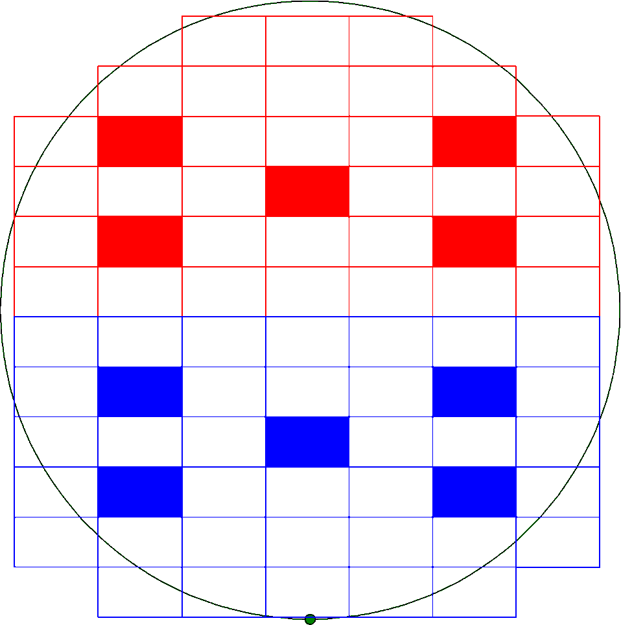
Reconstituted Wafer Overlay
Overlay can be enhanced by dividing wafers in to alignment zones
Multiple Zone EGA
Separate zone EGA. Useful for separate pick and place gantry heads that creates an array shift from one tool to the other.
Useful for non-linear die drift caused by thermal processes
US Patent: 8299446
ZONE 1
ZONE 2
Robert Hsieh/Slide 7

Slide 8
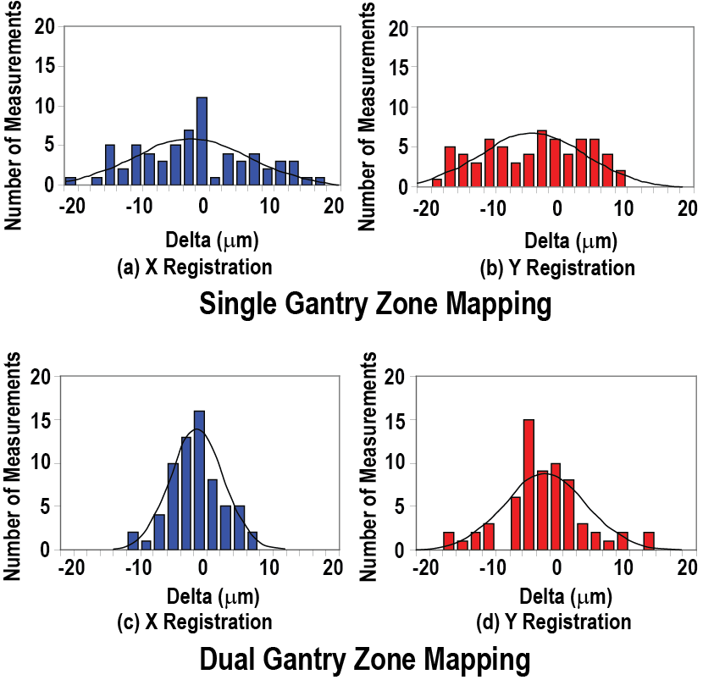
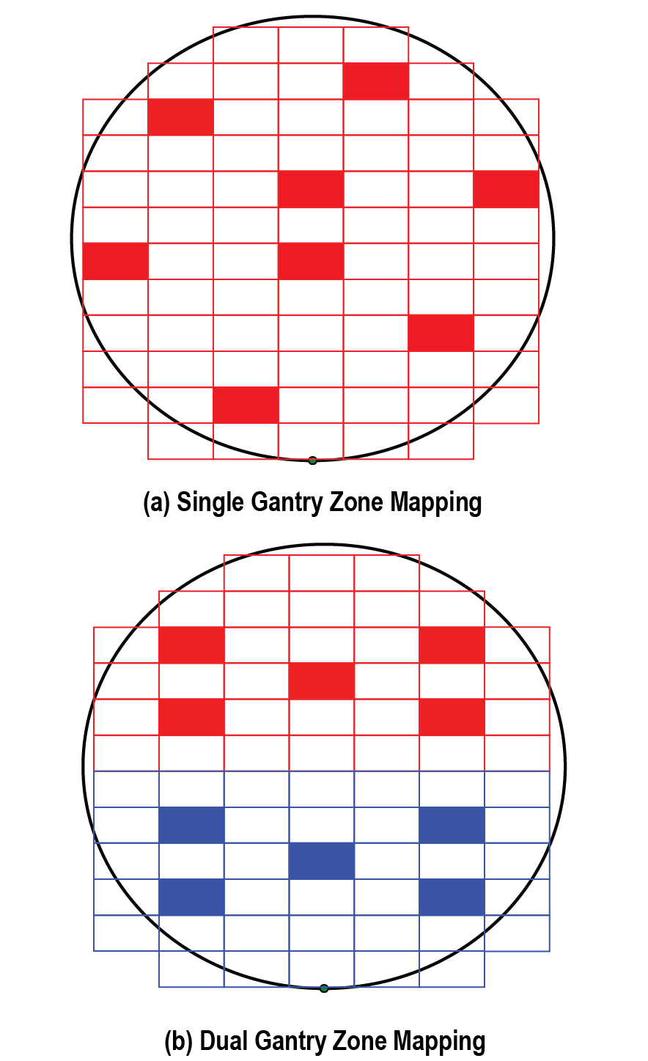
Multiple Zone EGA Overlay
3sigma = 26.3 μm
3sigma = 23.8 μm
3sigma = 13.6 μm
3sigma = 17.7 μm
Dual zone mapping giving a tighter, more Gaussian shape to the residual error distribution
Results from “Lithography Technique to Reduce the Alignment Errors ”, IWLPC Paper
Robert Hsieh/Slide 8

Slide 9
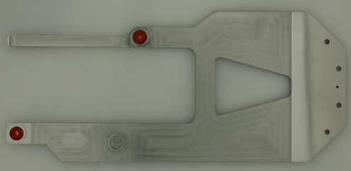
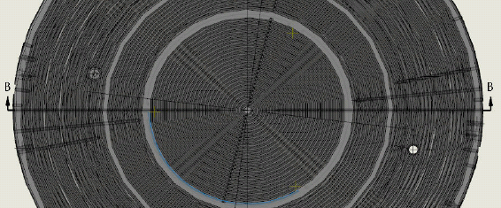
Warped Wafer Handling
Composite construction of reconstituted wafers results in more wafer warpage and less stiffness (sag)
Wafer automation must be capable of handling warped substrates reliably and accurately
End effector with suction cups
Chuck with enhanced flow and multiple vacuum zones
Increased height of lift pins to provide sufficient wafer clearance for robotic handling
Robert Hsieh/Slide 9

Slide 10
Focus control on non-flat substrates
For non-flat wafer surface special focus modes can be used to enhance focus control
Grid Focus Mode
Generates focus map of entire wafer before exposure
Determines local tilt and applies corrections during exposure
Red dots are field corner borders where focus is measured
At wafer edge additional focus measurements are made
Robert Hsieh/Slide 10

Slide 11
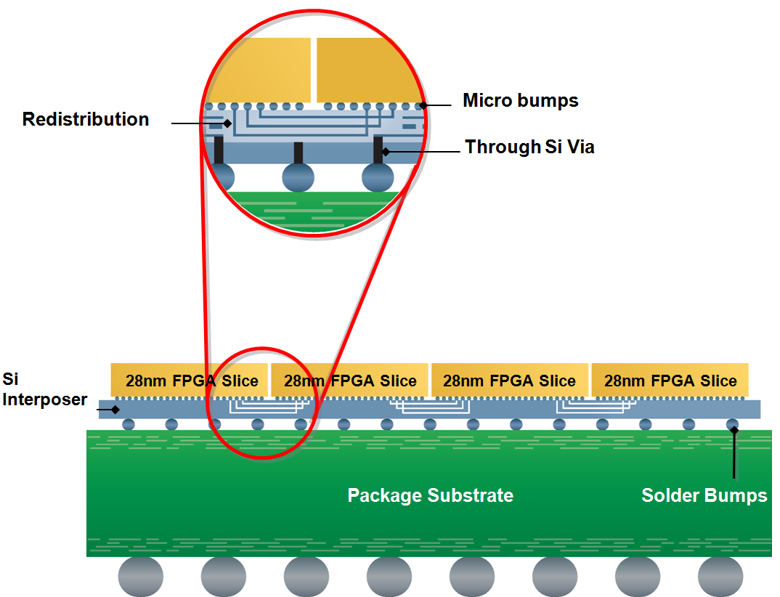
Silicon Interposer
Highlights
Si interposer technology is expected to gain significant traction for leading edge devices
Improved device performance of FPGA and GPU devices is expected to drive requirements
Si Interposer Structure
Robert Hsieh/Slide 11

Slide 12
Si Interposer Enabling Technologies
Implementing silicon interposer requires development of new process technologies
  Embedded target alignment for Through Silicon Via
    IR Alignment system
    Metrology
  Large area devices
    Field stitching
  Microbump
    Attach dies to the interposer
Robert Hsieh/Slide 12

Slide 13
Embedded target alignment
For Via Last process to form Through Silicon Vias the device layers and alignment targets are viewed through silicon
Process requires thinning the silicon with uniform thickness and polished surface for best image contrast
Robert Hsieh/Slide 13

Slide 14
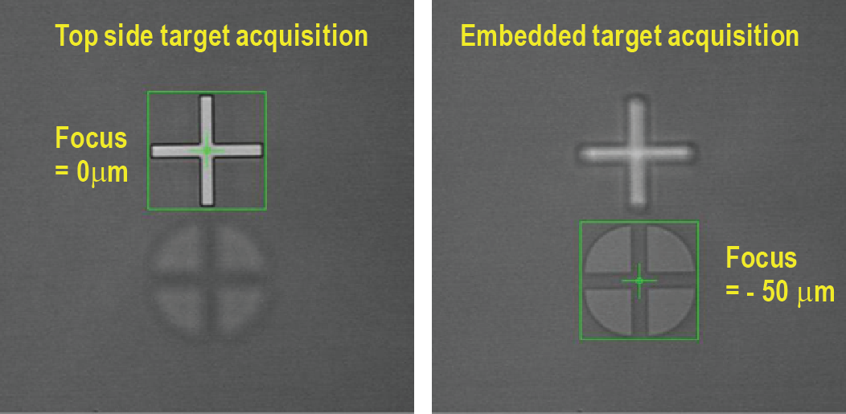
Stepper Self Metrology for
Dual Side Alignment
camera
Alignment system
camera
IR transmits through silicon
Top directed illumination allows for flexible placement of targets on the wafer
Off axis IR camera implemented on stepper
Measure XY positions of two features at different Z heights
Z offset
photoresist
photoresist
silicon
silicon
carrier
carrier
Back side metrology
Front side metrology
200 micron thick silicon
Results from “Verification of Back-To-Front Side Alignment for Advanced Packaging”, IWLPC Paper
Robert Hsieh/Slide 14

Slide 15
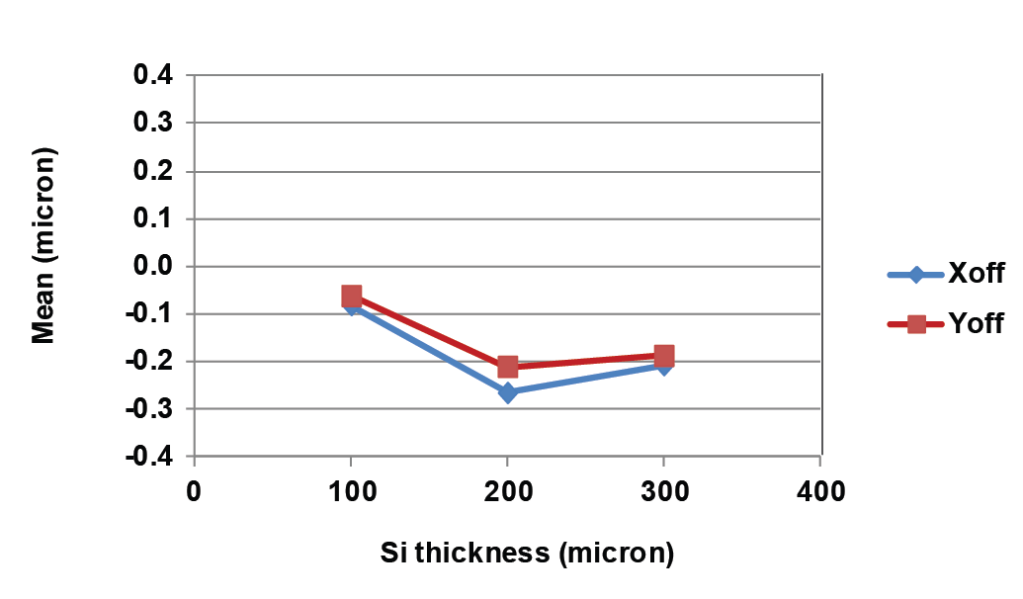
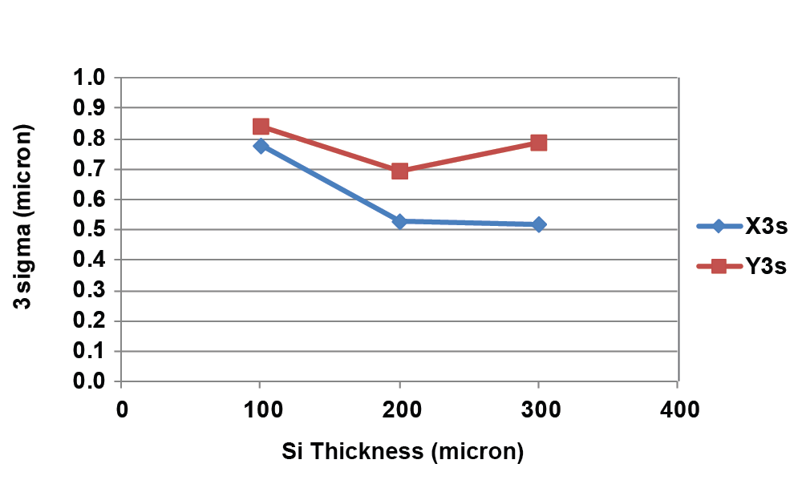
DSA Stepper Self Metrology
Embedded test wafers prepared using a copper damascene process
Wafers were thinned to thicknesses of 100, 200 and 300 microns and bonded to a carrier
Wafers were exposed on an AP300 stepper with DSA
Stepper self metrology was performed to collect data on five sites per field in eleven fields for a total of 55 sites per wafer
Mean plus three sigma was less than 1.0 micron for all three thicknesses of Si
Results from “Verification of Back-To-Front Side Alignment for Advanced Packaging”, IWLPC Paper
Robert Hsieh/Slide 15

Slide 16
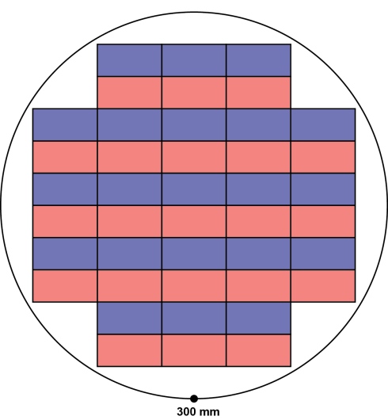
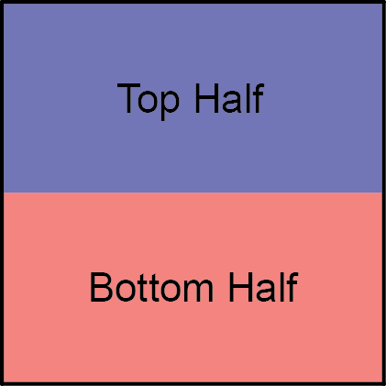
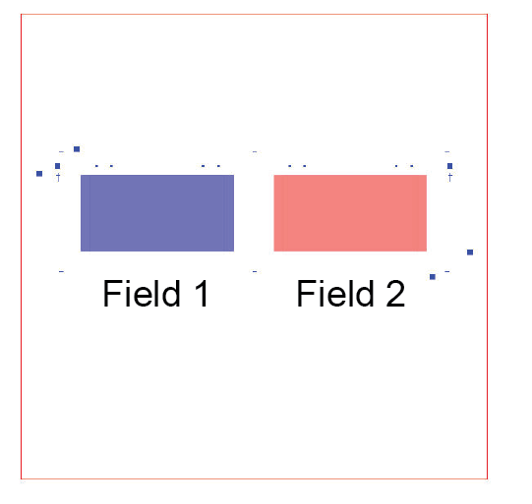
Large Area Interposer Lithography
Since large area interposer may be larger than the stepper field, the pattern can be constructed from multiple sub-fields
Test interposer design consists of a top half and bottom half
For stepper patterning both top and bottom sub-fields can fit onto a single 1X reticle
Wafer layout with stitched interposer
Standard configuration with two stepper fields can support up to 52 x 52 mm maximum square interposer
Robert Hsieh/Slide 16

Slide 17
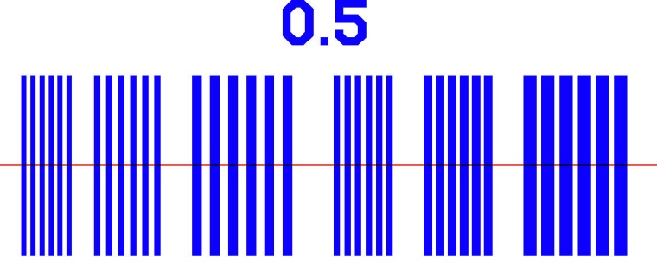
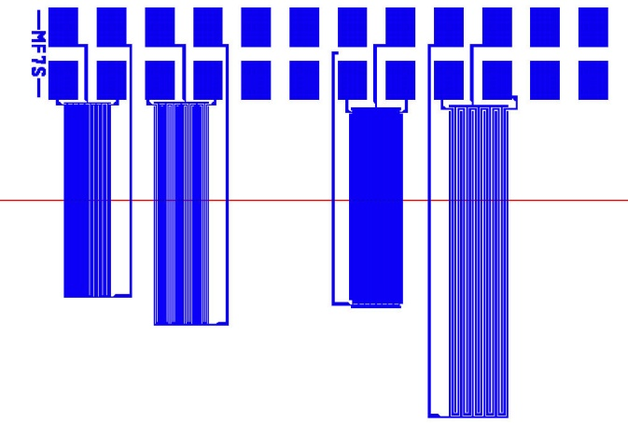
Stitching Performance Test Structures
Top half exposure
stitch line denotes sub-field boundary
Bottom half exposure
Line and Space structure with varying line/space pitch arranged from left to right, with smallest CD of 1.5 µm Line/Space
Stitch boundary contains multiple sets having different Y overlaps. For this set the top label denotes a 0.5 µm overlap.
Variable X offsets can be intentionally introduced between the top and bottom half
Serpentine/Comb structure to test integrity of lines crossing the stitch
varying line/space pitch arranged from left to right, with smallest CD of 1.5 µm Line/Space
Results from “Large Area Interposer Lithography”, ECTC Paper
Robert Hsieh/Slide 17

Slide 18
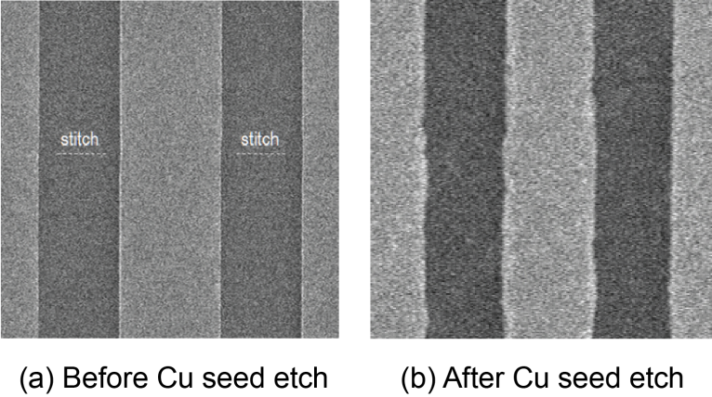
Electroplated Cu Across the Stitch
Top half exposure
Stitch line
Bottom half exposure
Top down view of Cu plated metal lines (a) before Cu seed etch and (b) after seed etch, for 3 µm pitch, line and space pattern
Line edge roughness becomes significant percentage of linewidth for smaller CDs
Line edge roughness can be reduced by using very thin seed layer
Results from “Large Area Interposer Lithography”, ECTC Paper
Robert Hsieh/Slide 18

Slide 19
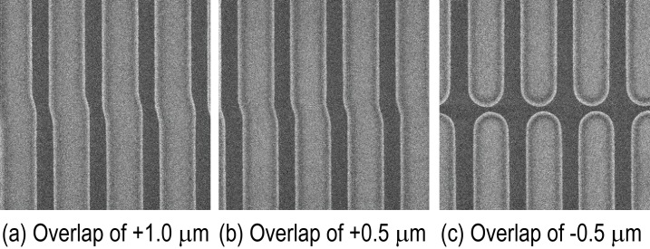
Intentional Offset Stitching Tests
Resist
Top half exposure
Stitch line
Bottom half exposure
3 µm pitch line/space structure
3.5 μm thick positive photoresist
Y overlap varied between ±1 μm
X stitch offset set at +0.25 µm
Results from “Large Area Interposer Lithography”, ECTC Paper
Robert Hsieh/Slide 19

Slide 20
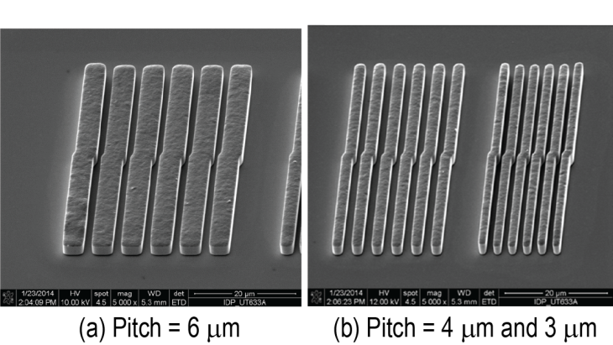
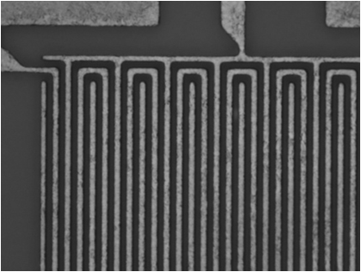
Electroplated Cu Structures Across Stitch
Pitch = 6 µm
4 µm line, 2 µm space
Pitch = 4 µm
Pitch = 3 µm
SEM of electroplated metal lines with introduced lateral offset at the field stitch of 0.25 µm.
Cu electroplated serpentine/comb structure with a 3 µm pitch with no offsets. Visual inspection reveals no line breaks or shorts in the structure.
Results from “Large Area Interposer Lithography”, ECTC Paper
Robert Hsieh/Slide 20

Slide 21
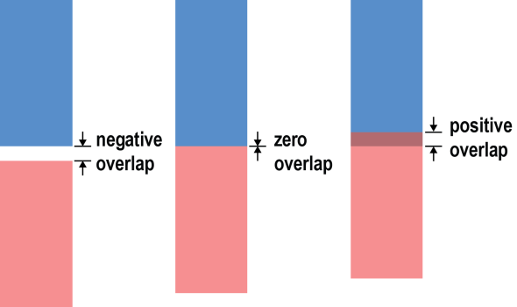
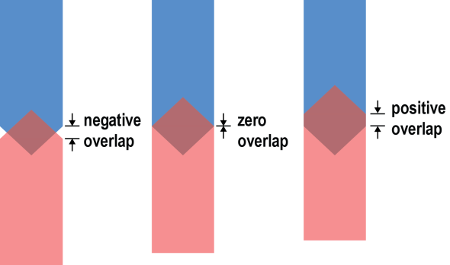
Modeling of Field Stitching
Top half exposure
Top half exposure
Bottom half exposure
Bottom half exposure
Square Line Ends
Tapered Line Ends
Simulated conditions for stitching line with square ends and 45 degree tapered ends
Varied lateral offset and vertical overlap
Top and bottom exposures are independently simulated
Results from “Large Area Interposer Lithography”, ECTC Paper
Robert Hsieh/Slide 21

Slide 22
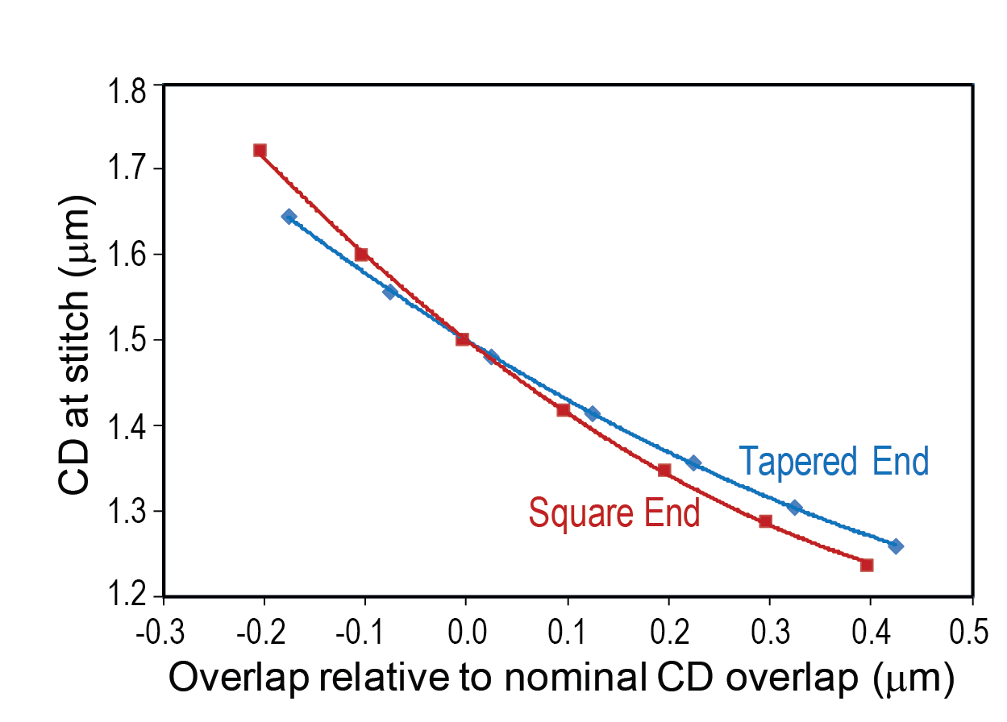
Simulated Stitch Performance for Square and Tapered Line Ends
+10%
nominal CD
-10%
Data from Prolith modeling of JSR IX845 resist for nominal linewidth of 1.5 µm.
The overlap range is 25% larger for the tapered line end relative to the square line end for a ±10% CD tolerance
Results from “Large Area Interposer Lithography”, ECTC Paper
Robert Hsieh/Slide 22

Slide 23
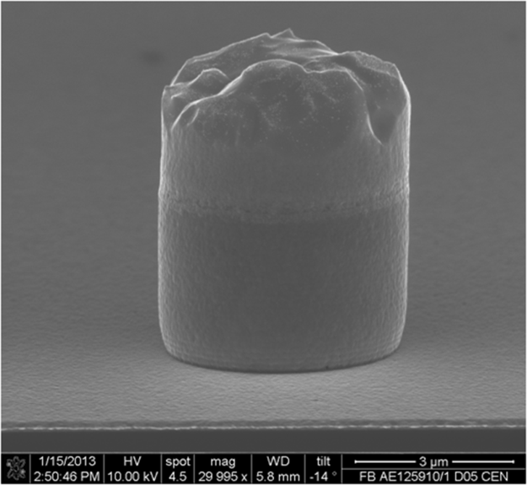
Microbump Lithography
3.5 micron microbump
Application includes 3D die-to-die and die-to-wafer stacking and interposers.
Maintaining lithographic process control for microbumping is challenging due to the small bump diameters and high aspect ratios.
Microbumps are formed by electroplating Cu inside 3.5 µm vias printed in 13.2 µm thick photoresist
Robert Hsieh/Slide 23

Slide 24
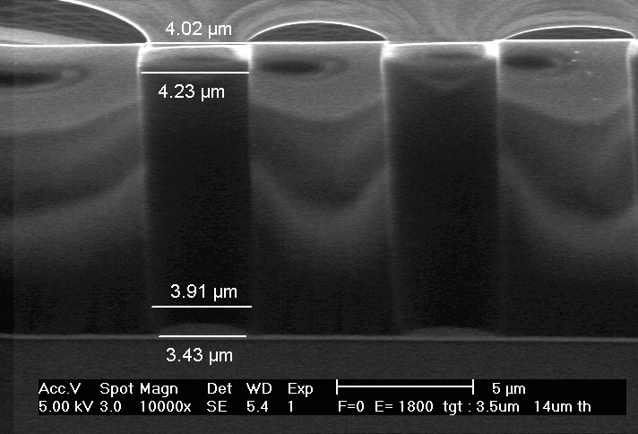
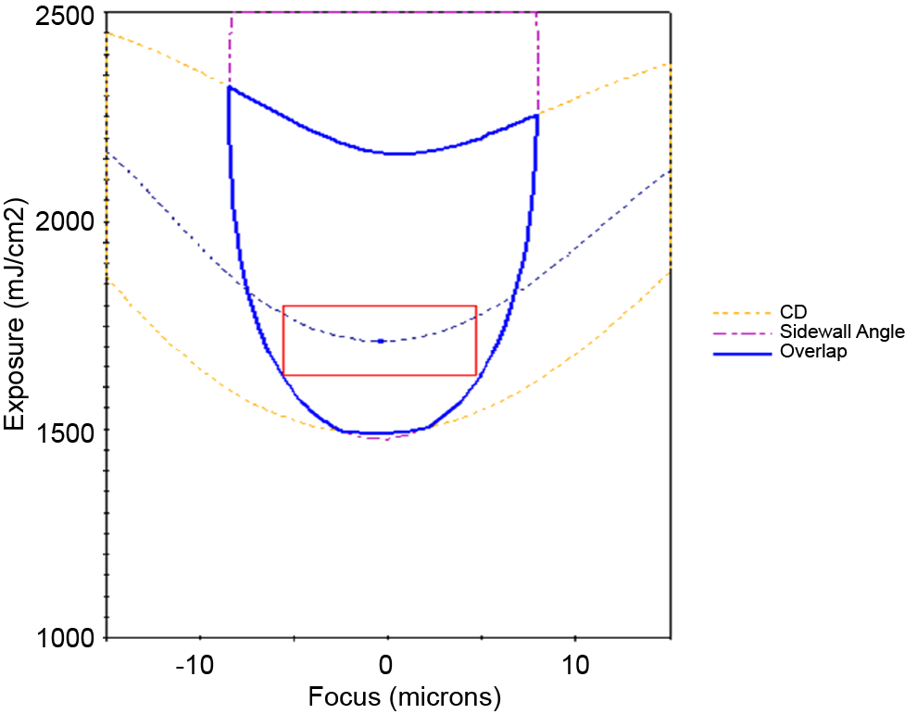
Microbump Experimental Results
Cross Section at Focus = 0 μm
Process Window DOF is 10.0 μm
3.5 µm CD with 10.0 mm pitch, AZ EM 10XT resist thickness is 13.2 mm
Process requirements are bottom CD of 3.5 µm ± 10% and sidewall angle > 87 degrees
CD data collected by top-down SEM and sidewall angle collected by cross-sectional SEM
Results from “Microbump Lithography for 3D Stacking Applications”, IWLPC Paper
Robert Hsieh/Slide 24

Slide 25
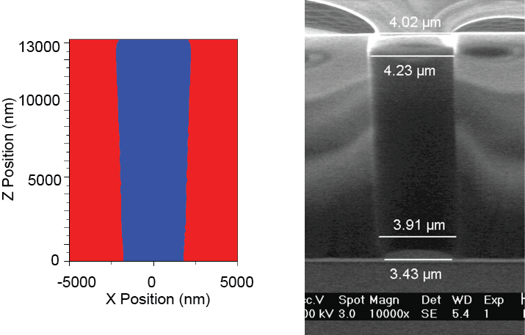
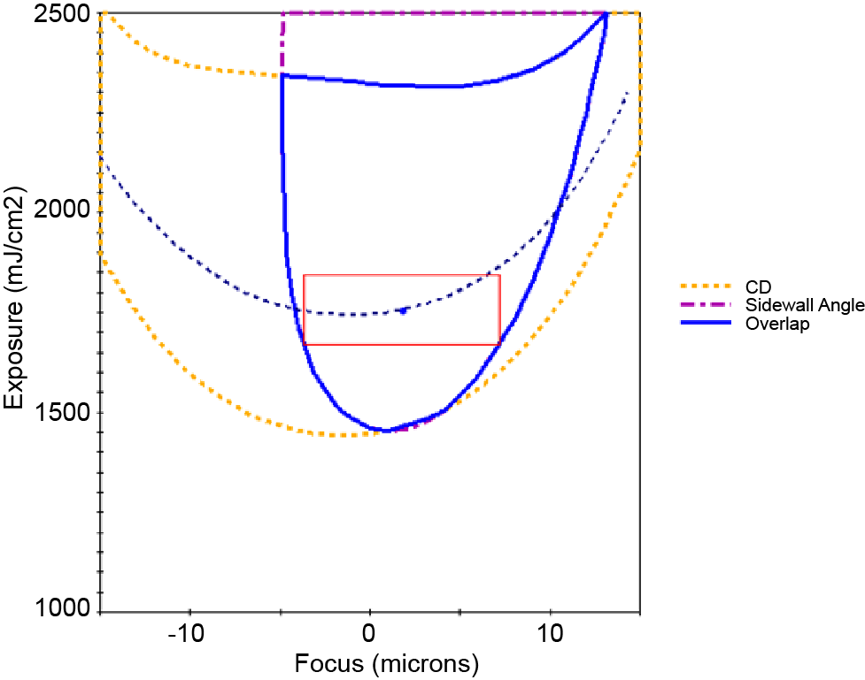
Microbump Lithography Simulation
Cross Section at Focus = 0 μm
Process Window
Simulations using KLA-Tencor Prolith (version14.1.1.1)
3.5 μm CD with 10.0 μm pitch, resist thickness is 13.2 μm
Process requirements are bottom CD of 3.5 μm ± 10% and sidewall angle > 87 degrees
Results from “Microbump Lithography for 3D Stacking Applications”, IWLPC Paper
Robert Hsieh/Slide 25

Slide 26
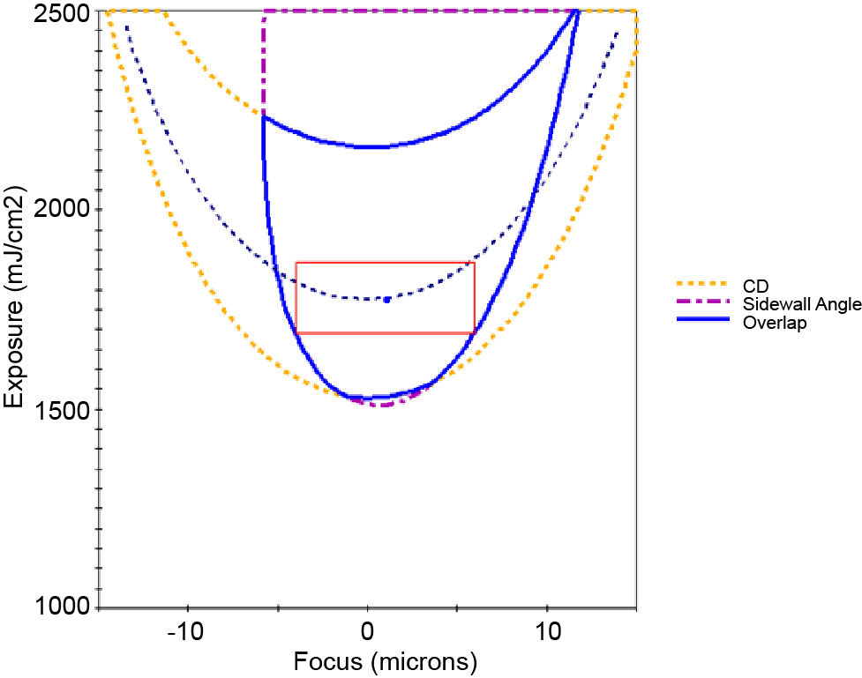
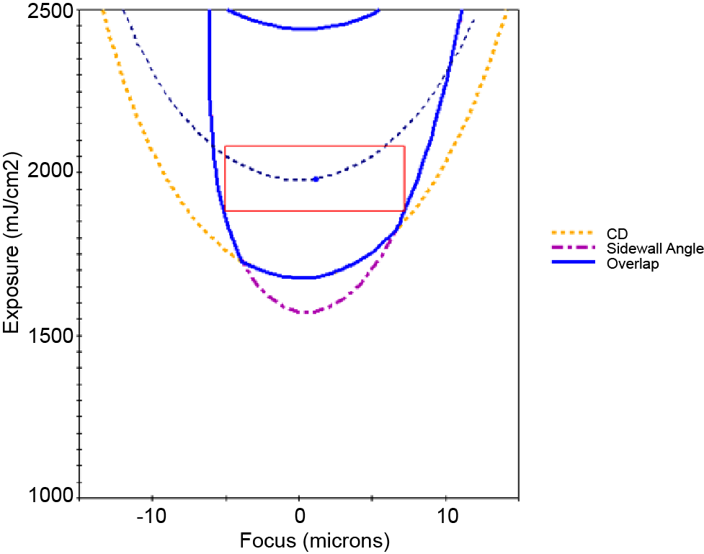
Microbump Process Scalability
2.5 μm CD
DOF is 9.9 μm
2.4 μm CD with 0.1 μm bias
DOF =12.3 μm
Photoresist simulation can be used to predict lithographic performance
2.5 μm CD with 7.0 μm pitch, resist thickness is 10.0 μm
Process requirements are bottom CD of 3.5 μm ± 10% and sidewall angle > 87 degrees
Results from “Microbump Lithography for 3D Stacking Applications”, IWLPC Paper
Robert Hsieh/Slide 26

Slide 27
Conclusions
Lithography capability is critical for extending advanced packaging technologies
Reconstituted Wafers
  Importance of EGA versus Site-by-Site alignment for throughput
  Multiple zone EGA developed for improved overlay while maintaining high throughput
  Warped wafer handling and focusing modes for non-flat wafers
Silicon Interposer Technology
  Back-to-Front Side Alignment and Metrology
    Alignment to embedded targets can be monitored using stepper self metrology
  Large Area Interposers
    Experimentally investigated patterning copper lines with lateral dimensions as small as 1.5 µm line/space in a vertically stitched large area interposer
  Microbump Lithography
    Experimentally investigated 3.5 μm microbumps with a 10.0 μm pitch
    Used resist modeling to predict the performance of 2.5 mm microbumps and ways to optimize the process window
Robert Hsieh/Slide 27

