Slide 1

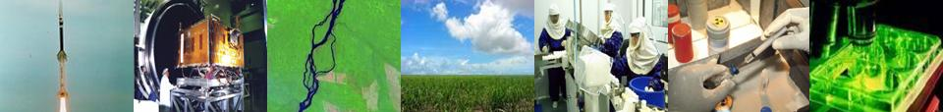
Dr. Carlos Moraes
Esp. Eng. Celso Peter
Dr. Eduardo Rhod
Dr. Willyan Hasenkamp
Semiconductor Market Trends in Brazil
KMEPS 2014
This material was elaborated with the collaboration of the Brazilian Embassy in Korea

Slide 2
Summary
Korea and Brazil?
Why Brazil represents an opportunity on semiconductor business?
Semiconductor industry in Brazil?
What are the trends and key forces for semiconductor industry in Brazil?
How to anticipate to this trends in Brazil?
Who is Unisinos?
1
2
3
4
5
6

Slide 3
korea and brazil?

Slide 4
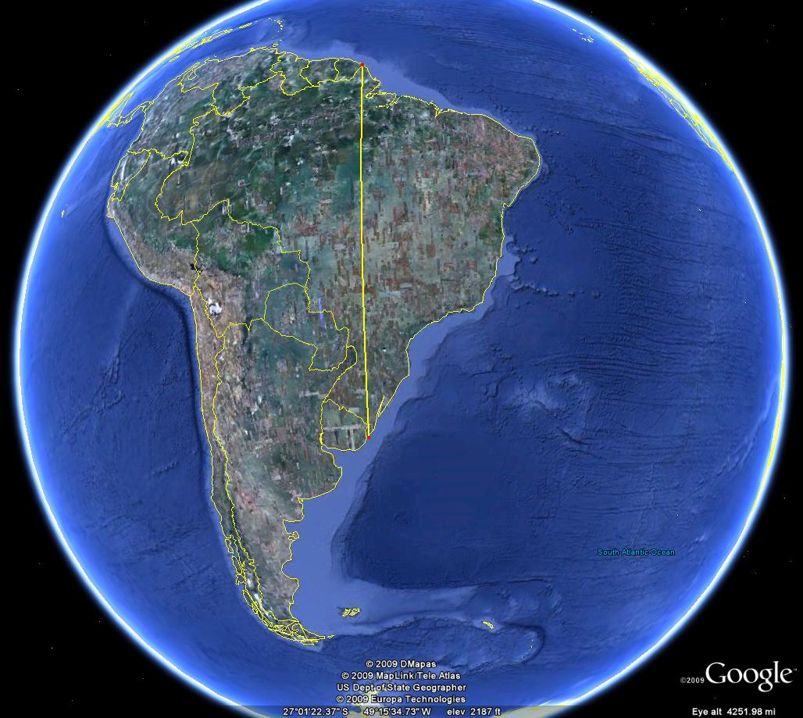
4,288km
4,200km

Slide 5
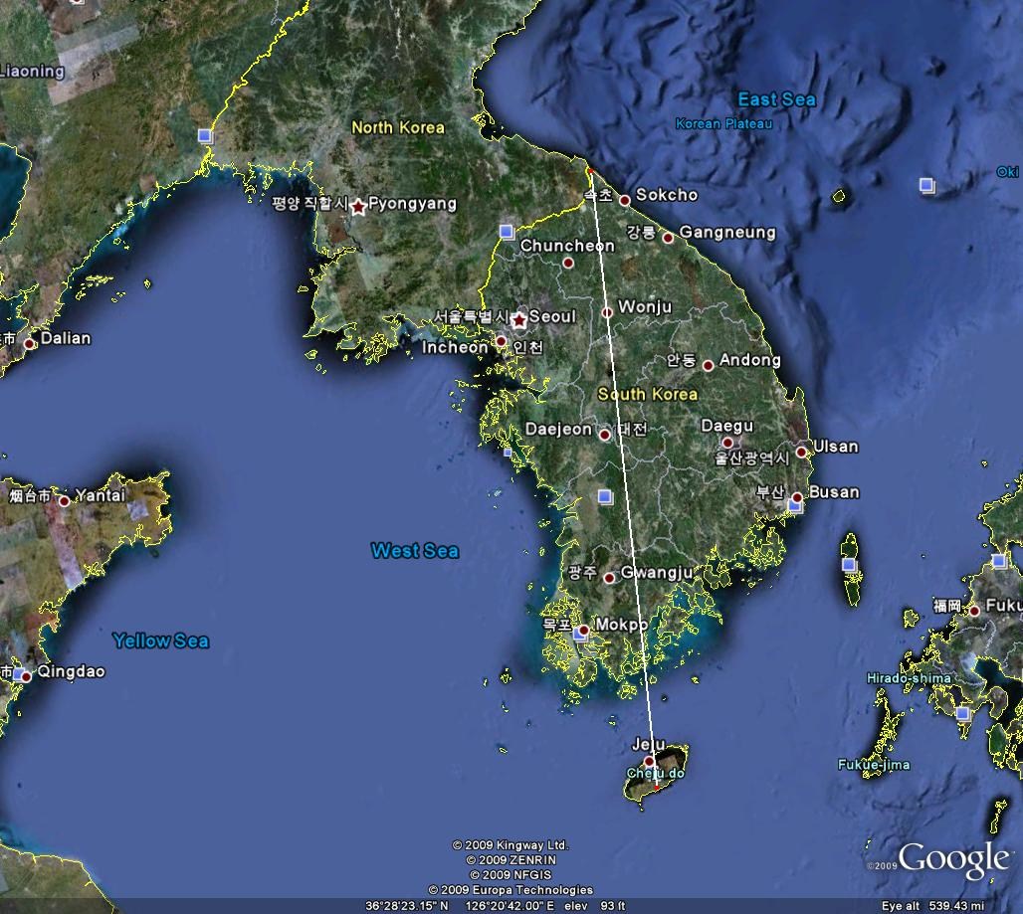
320 km
612 km

Slide 6
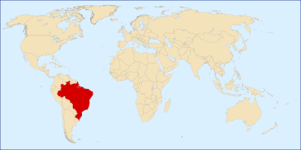
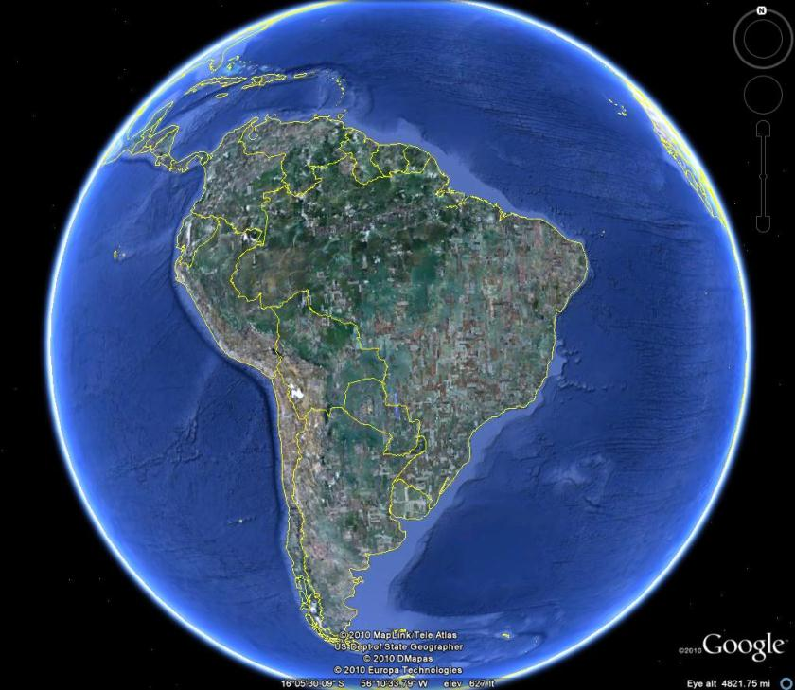

Distance: 19,000 km
Korea
Area：100,210 km² (108th)
Pop：48,875,000 (24th)
Brazil
Area： 8,514,876 km² (5th) (80x)
Pop： 194,227,984 (5th) (4x)

Slide 7
Brazil and the
Republic of Korea
General Data and Main Economic Indicators 2010
 | BRAZIL | KOREA
TERRITORY | 8,514,876 km² | 100,210 km²
POPULATION | 194,227,984 | 48,875,000
GDP | US$2,100 billions | US$ 1,014 billions
GDP PER CAPITA | US$ 11,185 | US$20,759
GDP REAL INCREASE | 7,5% | 6,2%
EXPORTS | US$180.997 billions | US$467.400 billions
IMPORTS | US$166.059 billions | US$425.700 billions
TRADE BALANCE | + US$14.9 billions | US$41.7 billions
INTL RESERVES | US$288.575 billions | US$291.600 billions
RANK IN THE WORLD ECONOMY | 7 | 15
Notes:
7

Slide 8
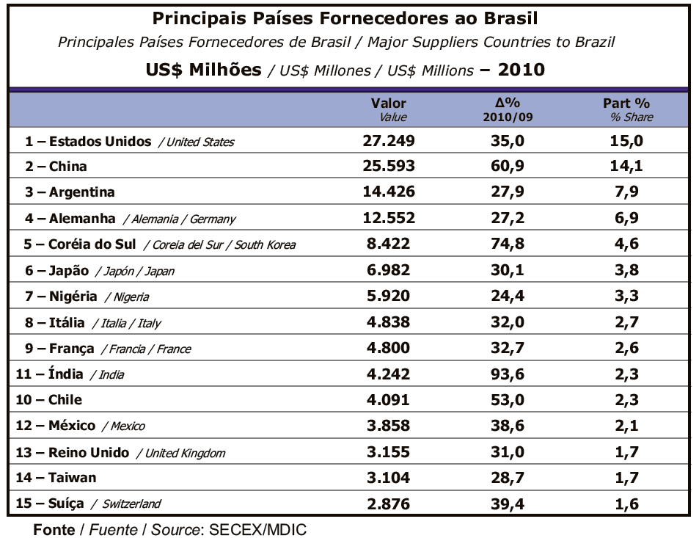
Notes:
8

Slide 9
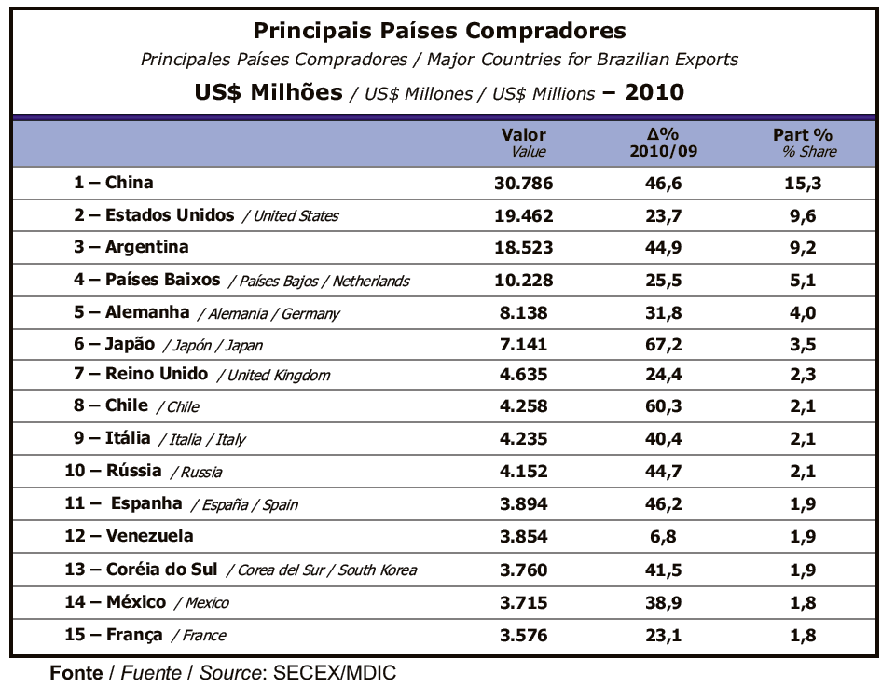

Slide 10
Main Brazilian
Exports to Korea - 2010
Rank | Products | Composition ratio | Value in US$ thousand | Changes
01 | Non-agglomerated iron ores and concentrates | 21.93% | 824,759 | 94.66%
02 | Semi-finished products of iron or non-alloy steel | 15,55% | 584,709 | 90.22%
03 | Agglomerated iron ores and concentrates | 10.03% | 377,177 | 585.7%
04 | Oil cake and residues after extraction of soybean oil | 8,08% | 303,970 | -10.99%
05 | Non-coniferous, Chemical wood pulp | 5.55% | 208,712 | 75%
06 | Ethyl alcohol | 5% | 188,051 | 34.78%
07 | Soy bean | 4.44% | 166,841 | -19%
08 | Cotton | 4.20% | 158,104 | 18%
09 | Copper ores | 3.12% | 117,383 | 61,2%
10 | Frozen cuts & offal of chicken | 2.07% | 77,736 | 7.74%
(Source: MDIC-SECEX)
Notes:
10

Slide 11
Main Brazilian
Imports from Korea - 2010
Rank | Products | Composition ratio | Value in US$ thousand | Changes
01 | Passenger cars, with sparking ignition internal combustion engine of a cylinder capacity over 1,500 cc. | 24.0% | 1,864,493 | 63.0%
02 | Other parts of radio-communication apparatus | 12.3% | 957,274 | -5.4%
03 | Liquid crystal devices for television and others | 6.3% | 490,326 | 82.9%
04 | Parts of color TV | 5.9% | 458,146 | 60.7%
05 | Autoparts | 3.7% | 283,585 | 427.3%
06 | Other heavy equipments for construction | 2.9% | 222,860 | 166.1%
07 | Gas oil | 2.8% | 213,294 | -44.4%
08 | Flat rolled products of iron or non alloy steel, coated with aluminium and others | 1.7% | 133,861 | 192.9%
09 | Motor vehicles for the transport of goods | 1.6% | 123,815 | 31.8%
10 | Jet fuel | 1.3% | 98,711 | 53.1%
Sub total | (1-10) | 62,5% | 4.846,365
(Source: KITA)
Notes:
11

Slide 12
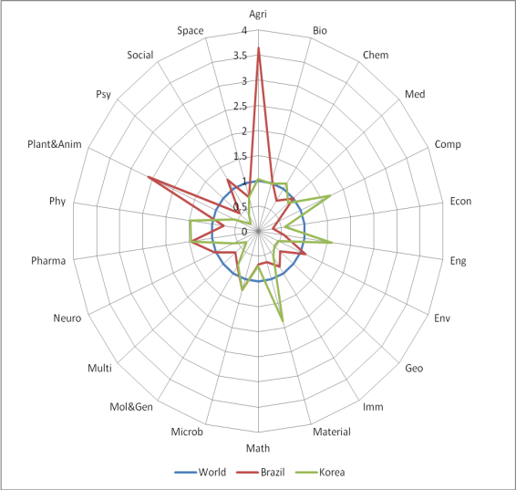
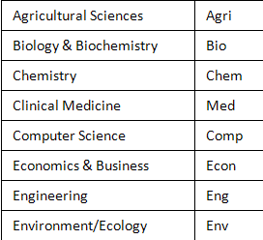
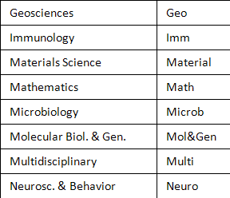
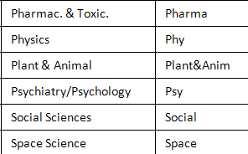
Specialization Index in Science and Technology for Korea and Brazil
National Science Indicators 2000~2009

Slide 13
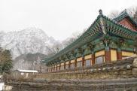


Some Comparisons
Undergraduate Courses
  Brazil: 7 engineers / 100 graduated
  South Korea: 22 engineers / 100 graduated
Research production in Engineering

Slide 14
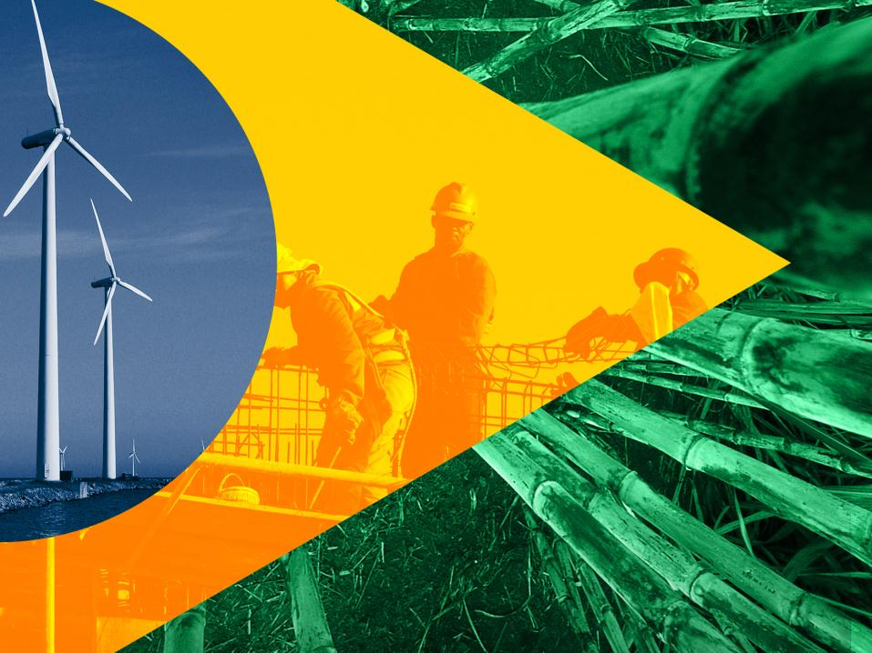
WHY BRAZIL
REPRESENTS
AN OPPORTUNITY
ON SEMICONDUCTOR BUSINESS?

Slide 15

Brazil and the World
Countries with population
> 100 million
Countries with area
> 4 million km²
Bangladesh
Nigeria
Russia
USA
Pakistan
Brazil
Indonesia
Australia
China
India
Canada
Japan
Mexico
Korea
France
Netherlands
Spain
Germany
UK
England
Italy
Countries with GDP
> US$ 1 trillion

Slide 16



Brazilian remarks in market and production
Largest consumer market in Latin America
3rd largest market of cell phones, cosmetics and soft drinks
5th largest market of personal computers
World’s 7th largest manufacturer and 4th largest consumer of automobiles
World’s 4th largest manufacturer of aircraft and top producer of models seating up to 120 passengers
Largest consumer market for renewable energies (UN)
Largest producer of biofuels

Slide 17

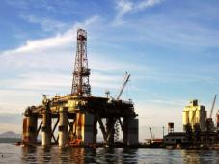

Brazilian remarks in market and production
Top 5 producer of medical and dental equipment
Home to the world’s 10th largest petroleum reserves
13th largest producer of scientific articles
10th largest industrial producer
Leader in production and exports of several agribusiness products
3rd overall largest exporter of agricultural goods

Slide 18



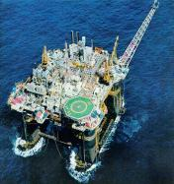

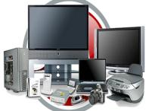
Booming sectors
Biofuels & Renewable Energy
Infrastructure
RE and Tourism
Electronic components
Oil & Gas
ICT
Notes:
Some of the most attractive sectors for foreign investment are these:
Biofuels and renewable energy where Brazil is a leader;
Infrastructure, due to the large number of upcoming projects;
Real Estate and Tourism, as Brazil is one of the countries where this sector is more dynamic;
Oil & Gas, as Brazil goes on with drilling its underwater oil reserves;
Telecomunications and IT, since Brazil has one of the largest consumer markets in the world for this segment;
Electronic components, to be used in all of these and many other industries.

Slide 19
Brazil at a Glance – Reasons to invest
1) Stable economic growth and social and environmental sustainability:
The solid Brazilian economic basis lead the country to a development cycle, with growth in GDP, stable financial system and important social gains.
2) Macroeconomic and social structure for a period of long-term transformation:
Macroeconomic policies adopted in Brazil in recent years were effective and led to inflation under control, soundness in its external accounts and improved risk profile.
3) Brazil has a strong domestic market:
With 192 million people, Brazil has a large and fast growing consumer market. Over the past 5 years, more than 24 million Brazilians moved out of poverty and another 27 million have been incorporated into classes A, B and C.
4) Cultural and natural wealth, vast and diverse population:
Brazil is a rich mix of cultures and ethnic groups, which shapes a plural and tolerant society. Large amount of natural resources available and over 300 million hectares of agricultural land in privileged geographic conditions are important to place Brazil as a key player in the international market.

Slide 20
Brazil at a Glance – Reasons to invest
5) Foreign trade - opening up markets and multilateralism:
Being the largest economy in South America, Brazil has been consolidating its position as an important commercial platform, as exports of its products and services have doubled in only 4 years.
6) The country of renewable, abundant and clean energy:
Brazilian energy is abundant and diverse. The country is self sufficient in oil and has several sources of clean energy such as hydro energy, wind power and ethanol. Today, 46% of energy production in Brazil is based on renewable sources.
7) Democratic and institutional stability:
Since 2008, Brazil is classified as investment grade as the institutional environment ensures security to investors, who can also count on a modern and efficient financial system. Moreover, foreign investors have security and legal permission to send profits to their home countries, and foreign capital is considered as if it were national.

Slide 21









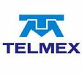





























More than 90% of the largest MNCs have been in Brazil for a long time
(Non exhaustive list)
Notes:
As we see, more than 90% of the largest MNCs have been in Brazil for a long time.
And they have been doing very well, always expanding their business and finding new opportunities to growth.

Slide 22
semiconductor industry in Brazil?

Slide 23
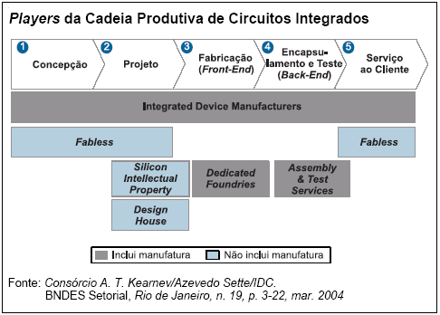



Semiconductor
Production Chain in Brazil
Small companies
&
Research University Labs
Joint Venture
Brazil Korea
Commercial Scale
20 Design Centers
CI Brasil Program
CEITEC

Slide 24
Semiconductor
Production Chain in Brazil
There is no yet consolidated
production chain in Brazil
  Mainly on potency devices (Semikron, Aegis) and Backend (Smart, HT Micron)
Universities
  ~20 produce design (3 in RS state)
    18 design houses (CI Brazil Program)
    2 designer formation centers
  ~6 do research on production processes

Slide 25
Semiconductor
Production Chain in Brazil
Designers ~ 500 persons

Slide 26
the trends and key forces for semiconductor industry in Brazil?

Slide 27
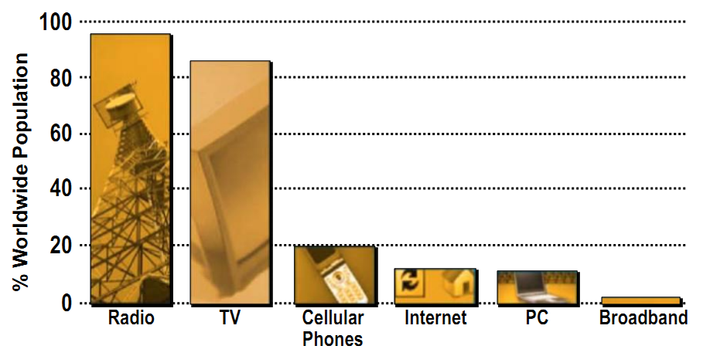
Technology Adoption in the World 2010

Slide 28
Communications Technology Adoption in Brazil 2007~2010
INDICATORS | UNIT | 2007 | 2008 | 2009 | 2010
MOBILE ACCESS
Cellular phone lines | Millions | 120,9 | 150,6 | 173,9 | 202,9
Density of cellular phone lines | Accesses / 100 habitants | 63,6 | 78,1 | 90,5 | 104,7
MULTIMEDIA COMMUNICATION
Fixed Access | Thousands | 8.771,3 | 11.401,9 | 12.997,6 | 15.473,0
Density of Fixed Access | Accesses / 100 residences | 4,58 | 5,91 | 22,40 | 26,00
ANATEL
National Agency of Telecommunications
2011

Slide 29
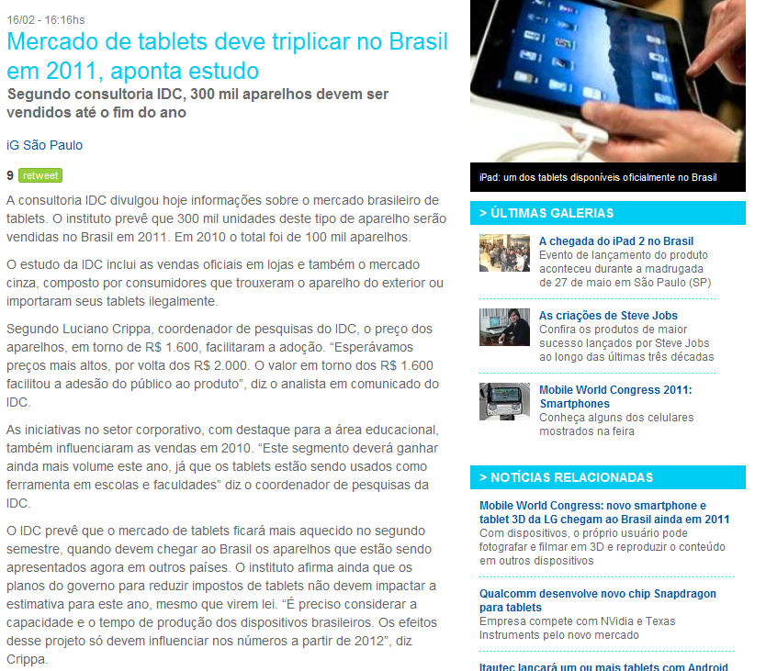
Some News in Brazil...
Feb 2011
Accordingly to IDC study, Brazilian market in 2011 will reach 300.000 tablets
In 2010, about 100.000 tablets were sold in Brazil

Slide 30
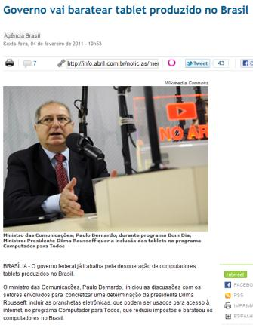
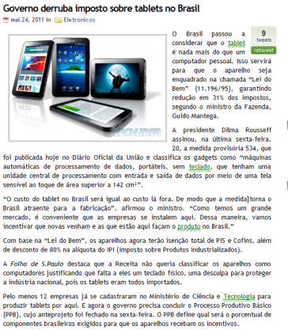
Some News in Brazil...
Feb 2011
Proposal to reduce the costs of tablets in Brazil
May 2011
Decision from Brazilian Government to reduce in 31% the taxes over tablets

Slide 31
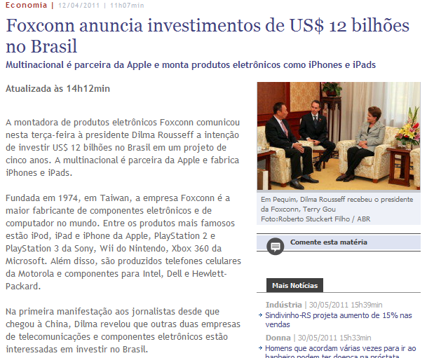
Some News in Brazil...
Apr 2011
USD 12 billion on investment from Foxconn in Brazil

Slide 32

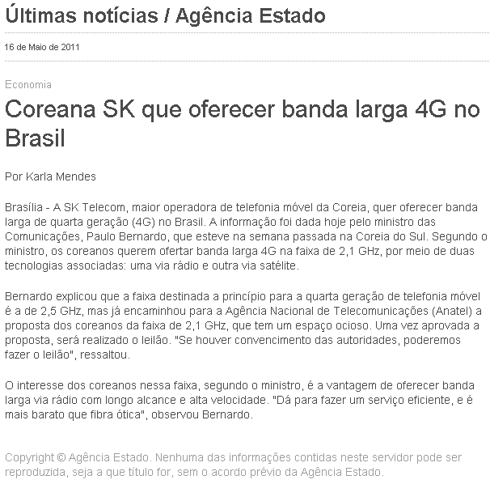
Some News in Brazil...
May 2011
SK – Korean Company offer 4G broadband in Brazil

Slide 33


Present and Forthcoming Elements
Accelerated Growth Program (PAC)
  To develop key infrastructure elements in Brazil
Events
This is the Main event!!!
Nobody
remembers
that!!!

Slide 34
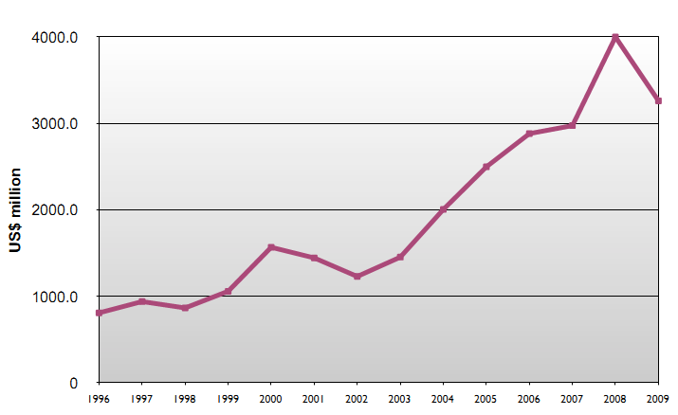
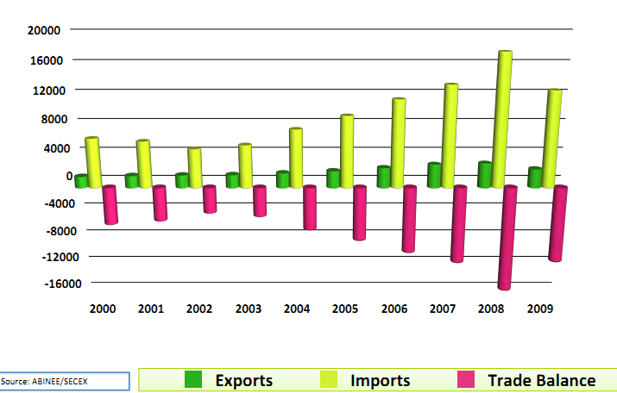
Brazil
Electronic Components
IC Imports

Slide 35
Brazil
Components Trade Balance
US$ Million (FOB)

Slide 36
Semiconductor Balance Estimates in 2010...
Imports
USD 22,4 Billion
Exports
USD 5 Billion
Workforce
Deficit
USD 17,4 Billion
Semiconductors
USD 2,1 Billion
(Non assembled chips)
Intelectual Property
(50% on components)

Slide 37
Semiconductor
Production Chain in Brazil
Brazil represents 4% of the world market in computers
Semiconductors is priority Brazilian government agenda
Federal incentives
  PADIS
  PPB

Slide 38
PADIS
Brazilian Law 11.484 (31/05/2007) – Brazilian Program for Support of the Development of Semiconductor Industry
Intended for enterprises who produce, in Brazil:
  Design
  Diffusion
  Packaging
Applicable to LCD, LED, OLED, Solar cells, Non-volatile memories based on COB, and Printed circuits
Benefits
  Reduction to ZERO of federal taxes (PIS/COFINS, IPI, IR)
Counterpart
  Invest 5% of gross revenues in R&D
    At least 1% external (Brazilian research center)

Slide 39
PPB
Brazilian Laws for Basic Productive Processes (8.248/91, 10.176/01, 11.077/04)
Applicable to chips, memory modules, solar cells, notebooks, tablets
Benefits
  Reduction of 80% of IPI federal tax
Counterpart
  Components: mount in Brazil
  Memories: packaging in Brazil
  Invest 4% of gross revenues in R&D
    At least 1,84% external

Slide 40
HOW TO ANTICIPATE
TO THIS TRENDS
IN BRAZIL?

Slide 41
One Suggestion:
The 2+2 Model
Brazil-Korea S&T cooperation agreements
S&T policies including government financial support
South Korea
Brazil
Research Institute / University
Research Institute / University
Private company
Private company
Partnership
Internal / Global market

Slide 42




Brazil-Korea Cooperation in Semiconductors
(A Case of the 2+2 Model)
Goal 1
-----------------
Strong Support
for
Semiconductor
Back End Manufacturing Line
Kick-Off: 2012.03
Expertise
Funding
Expertise
Funding
Legal Benefits
Brazilian
Government
Goals 2 & 3
-----------------
Partnership and Collaboration for other Semiconductor Korean Companies in Brazil
Project Demands
Training Demands
Funding
Korean
Government
Semiconductor Research Institute
Research Partners
TECNOSINOS
Technology
Park
Exchange of
Knowledge
and Knowing
Land
Funding
R&D HR
Training
R&D HR
Training

Slide 43
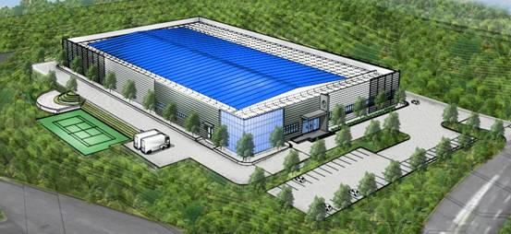
HT Micron ICs at UNISINOS

Slide 44
WHO IS UNISINOS?

Slide 45
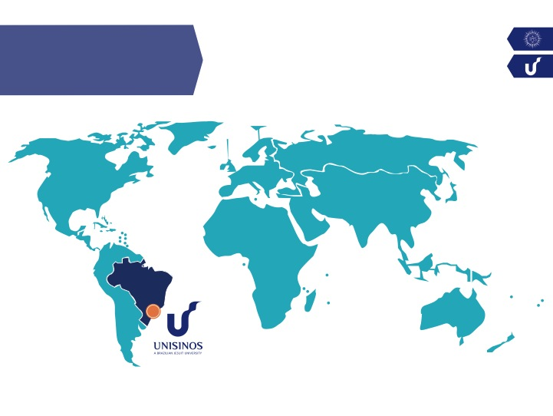
UNISINOS
LOCATION
SÃO LEOPOLDO, RS, BRAZIL

Slide 46
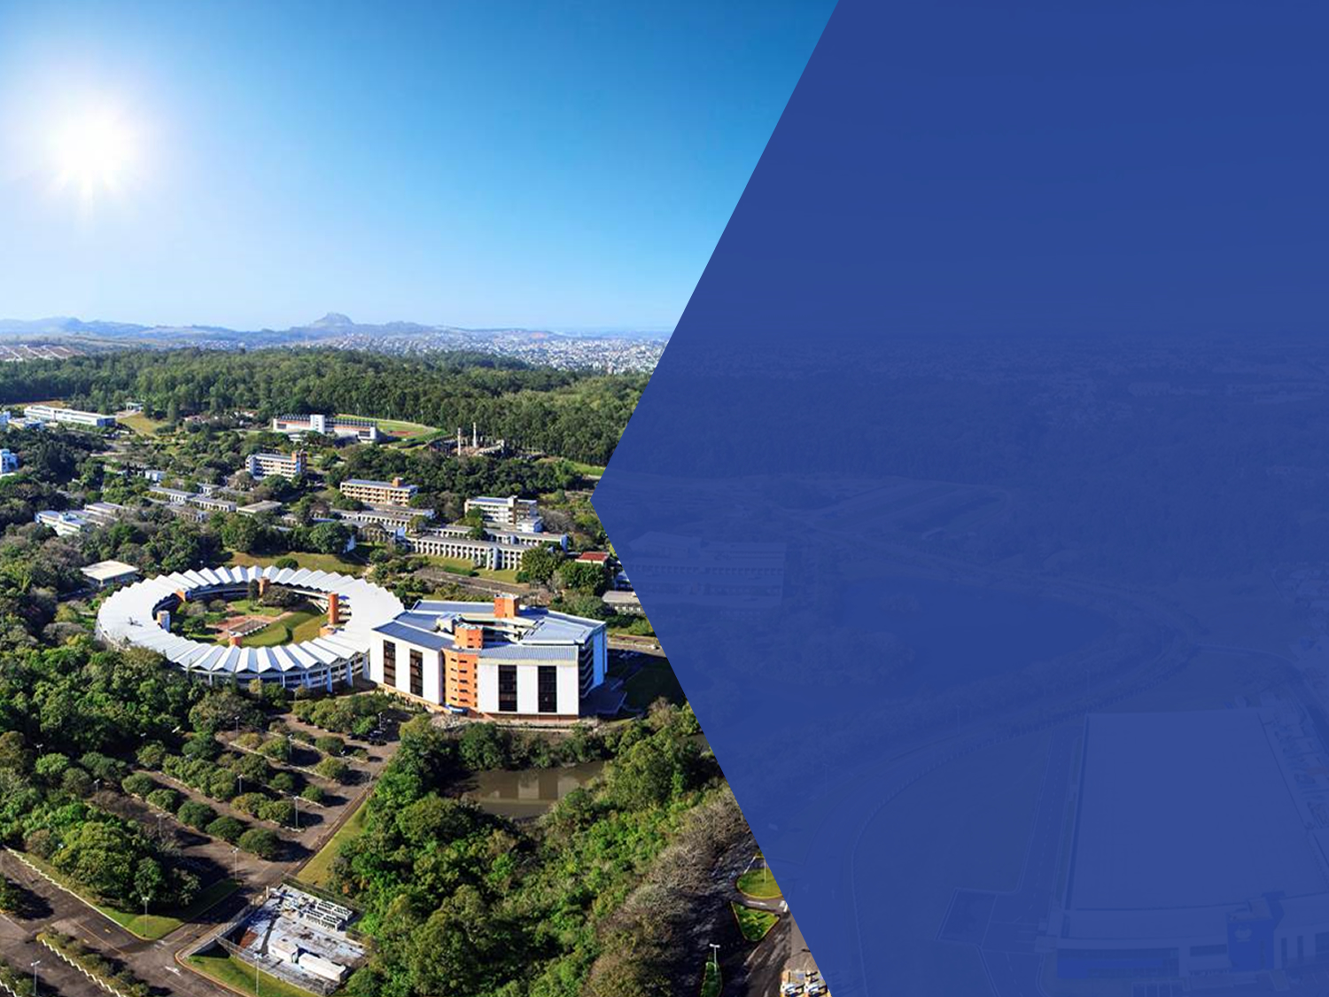
A JESUIT UNIVERSITY
UNISINOS belongs to a global universities network supported by the Jesuits Corporation, and was founded in 1969, in Southern Brazil.
UNISINOS has been employed efforts in order to contribute to a regional development through education, research and social and business initiatives. The investment in research, technology and innovation with a global strategic orientation have been one of the drivers for setting a new knowledge economy in the region as a global research University.

Slide 47
UNISINOS
NUMBERS
+33,000
students
3,065
2,300
people impacted by activities in company
90
collaborators
undergraduate programs
6,000
450
1,405
25
research projects each year (30% of those with companies or organizations)
students on masters and Ph.D programs
new students each year
master
programs
+500
+700
6,884
14
Ph.D
programs
thousand itens in one of the largest libraries in Latin America
students in Lato Sensu/MBA
continuing education courses

Slide 48
UNISINOS SYSTEM OF SCIENCE, TECHNOLOGY AND INNOVATION
ACADEMIC
(courses / programs)
14 Ph.D Programs
25 Master Programs
92 Research Groups
450 Research Projects
TECHNOLOGICAL INSTITUTES
Itt CHIP (semiconductors)
Itt FUSE (automation)
Itt FOSIL (micropaleontology)
Itt NUTRIFOR (nutraceuticals)
Itt PERFORMANCE (civil construction)
Other Labs of R&D&I
NITT
TECH PARK
(TECNOSINOS)
75 Companies
40 Incubated Companies
5,300 jobs
US$ 600 million

Slide 49
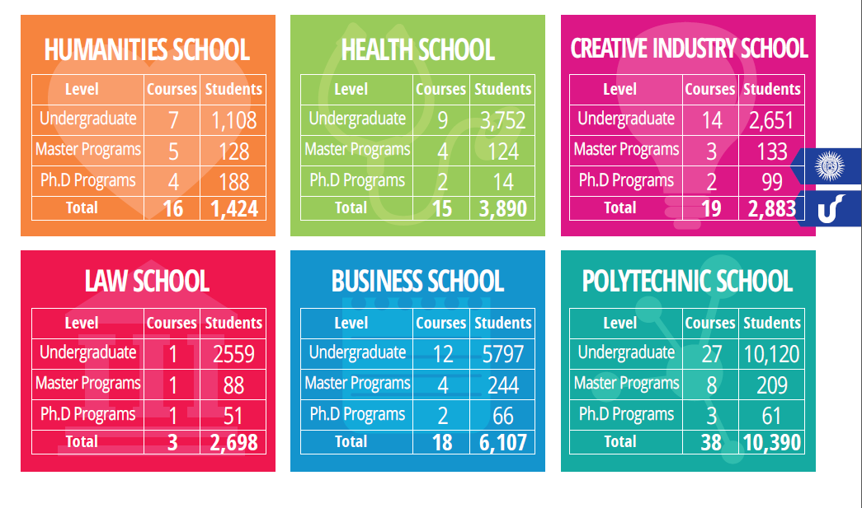
UNISINOS SCHOOLS

Slide 50
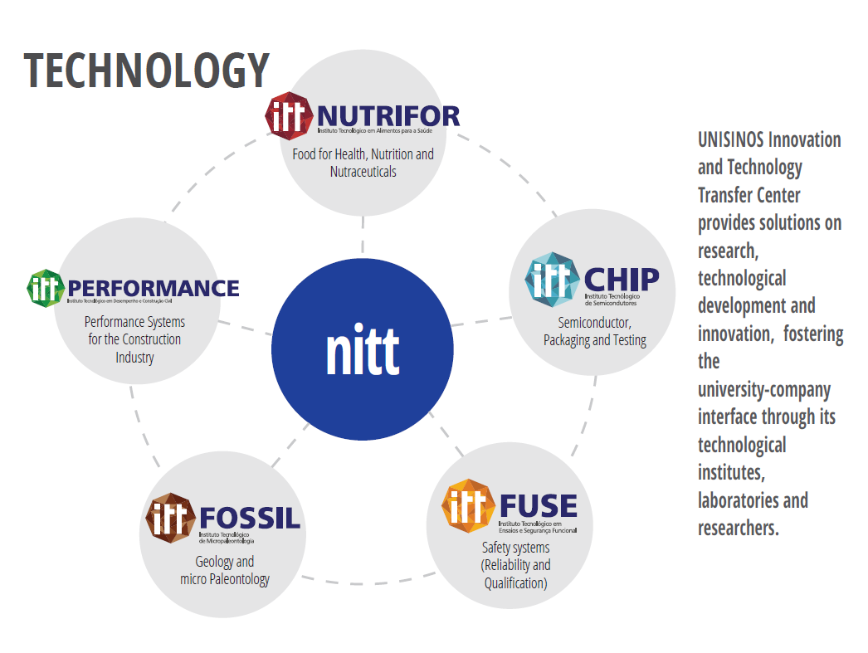

Slide 51
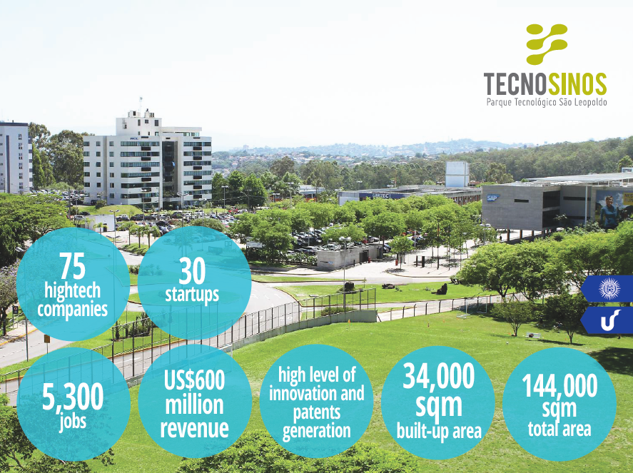

Slide 52
INTERNATIONAL COOPERATION OF
UNISINOS
OVER 120 PARTNER UNIVERSITIES WORLDWIDE
NORTH AMERICA + 10 PARTNER UNIVERSITIES
EUROPE + 50 PARTNER UNIVERSITIES
ASIA + 10 PARTNER UNIVERSITIES
LATIN AMERICA + 50 PARTNER UNIVERSITIES

Slide 53

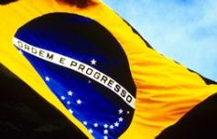




Obrigado!
Thank you!
감사합니다!
Eduardo Luis Rhod, Dr.
ELRHOD@unisinos.br
Carlos Moraes, Dr.
CMORAES@unisinos.br
Willyan Hasenkamp, Dr.
WILLYANHC@unisinos.br
Celso Peter
CERPETER@GMAIL.COM
Notes:
53

